Slide 1


Eye-Tracking Data Visualization
NASA Ames Research Center

Slide 2
How We Got Here

Slide 3
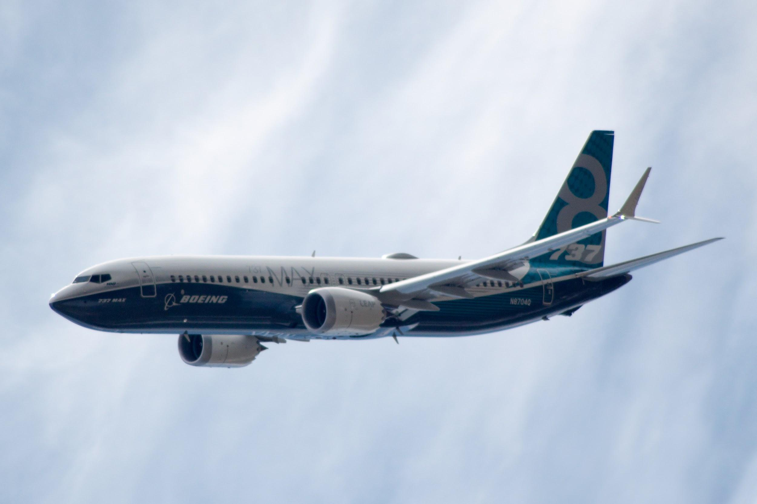
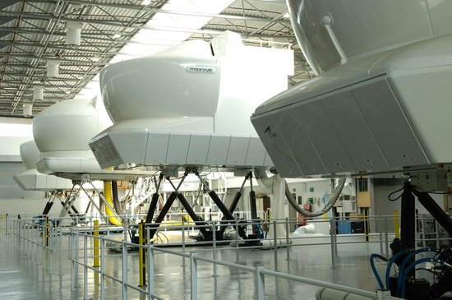
Crisis in Training
After a series of two devastating and fatal Boeing 737 Max 8 crashes in late 2018, an internal investigation revealed that rather than provide simulator training to pilots, Boeing provided them with a two-hour course on the iPad
The reason for the lack of formal training was the cost
Notes:
A key bottle-neck in the return of 737-800 planes to the sky's, is the speed at which pilots can be re-trained in flight simulators.
The original intention behind the MCAS was so pilots trained in flying 737-700 aircraft didn’t need to undertake expensive simulator training to fly the newer models.
A single full-movement 737 Max simulator is estimated to cost up to $15 million, and the hourly cost to run them is in the hundreds of thousands.
Only 34 of these simulators exist worldwide, with only two companies manufacturing them.

Slide 4
$12,000,000
The estimated cost of one Boeing 737 Max flight simulator

Slide 5
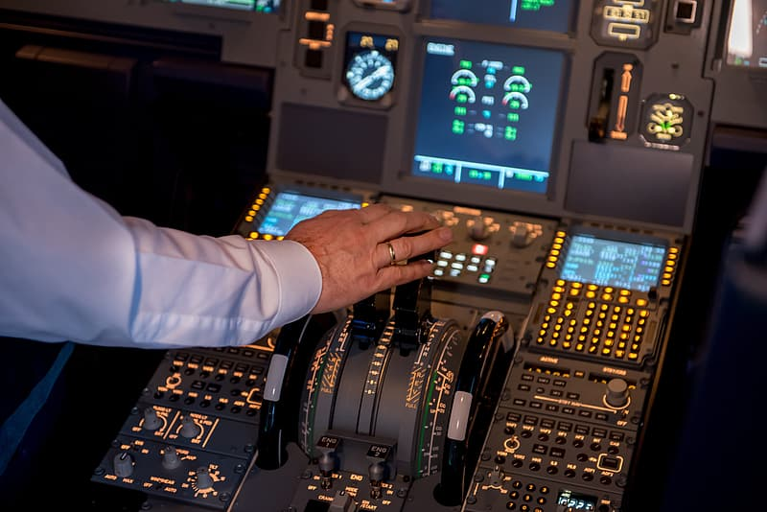

Research Into Human Systems Integration
As a result of the fatal crashes, NASA commissioned 19 Alaskan Airlines pilots to undergo multiple flight simulations
The pilots were presented different situations and their eye-movements were tracked as alerts and warnings appeared
Notes:
NASA commissioned 19 Alaskan Airlines pilots to participate in various flight simulations. While being presented with different flight situations, the researchers gathered eye-tracking data.
As various stages of the flight progress, the researchers estimate that different components on the flight deck will be more important, and the pilots will increasingly focus on them.

Slide 6
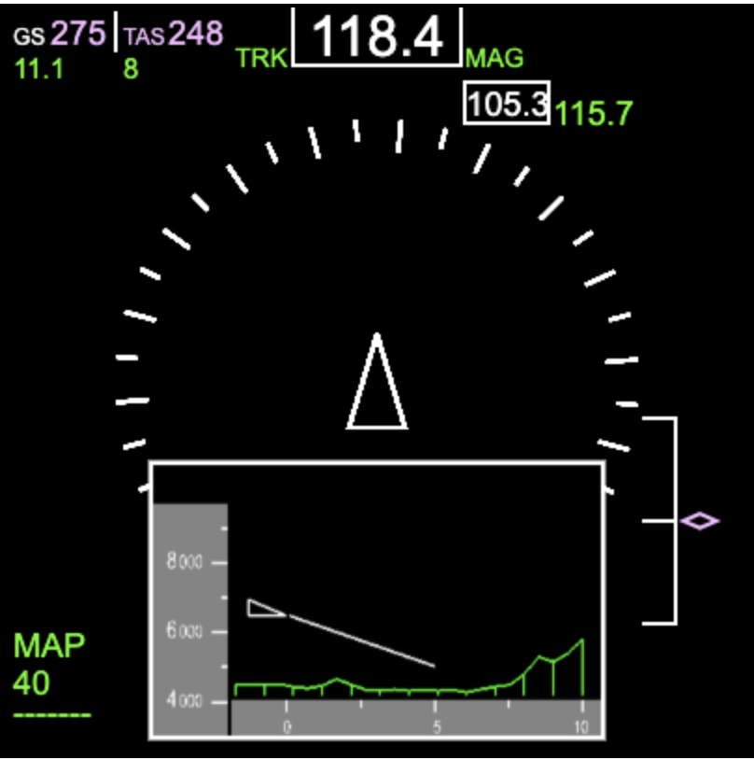
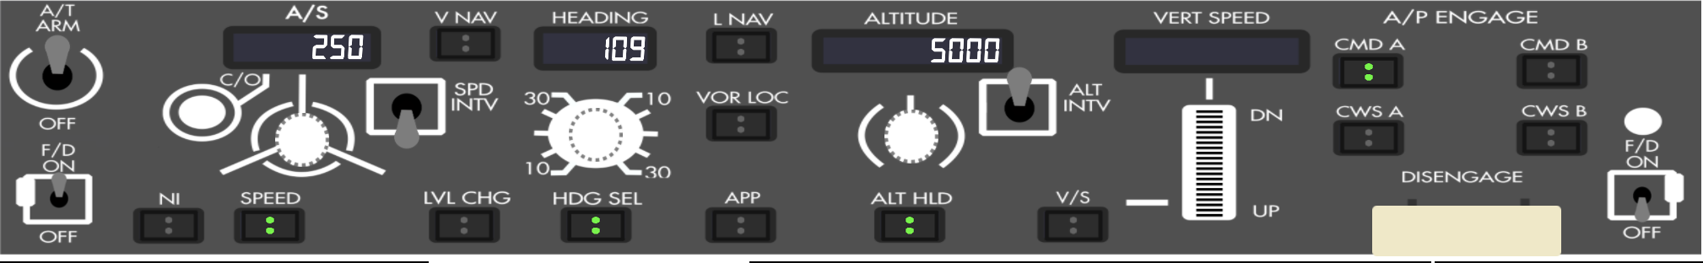
Need for Data Visualization
Once the eye-tracking data was collected, there came a need to overlay that data onto the flight panel
NASA teamed up with the Division of Data Science at UC Berkeley to complete this project
Notes:
The first roadblock ARC faced was an inability to clearly evaluate large swathes of data. Both simulator, and eye-tracking files are CSV files 80 megabytes large, with about 100 flight variables to keep track of.
Additionally, the eye-tracking data was collected at 60 hertz while the simulator data was collected at 6 hertz. A need was quickly presented for a clean, organized, and synchronized method to visualize three different data streams.
Unfortunately, no current display panel with the technical specificity ARC required existed.

Slide 7
Engineering Challenges

Slide 8
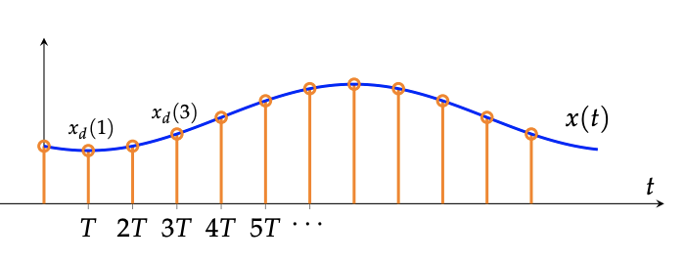
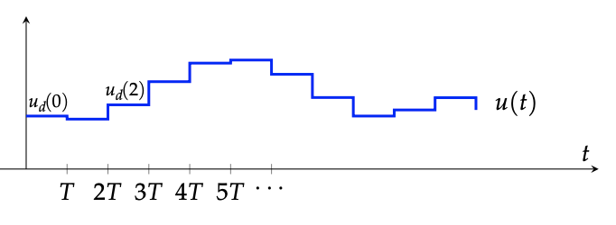
Dealing with Data
Addressing the frequency mismatch between the various datasets
Synchronizing hundreds of individual components on the UI
Speeding up the file reading
Overlaying the eye-tracking data onto the flight panel
Designing accurately scaled and proportioned instrument panels
Notes:
The first and most pressing challenge was addressing the frequency mismatch. Our team created a one-order hold. Keeping the simulator data constant while the eye-tracking caught up.
Next was simply managing about a hundred different variables, displaying them, and ensuring that the data was synchronized.
A web-based approach relying on HTML Canvas for animation and a NodeJS server on the backend was used. Reading in the data from a JSON file, initialized before hand, to speed up file-reading, our team needed to carefully design our code to ensure nothing ran too slow. Since the simulator is playing a hundred or so variables at the same time, and on top of that overlaying eye-tracking data, code must be written with both space and time efficiency to ensure data doesn’t fall behind.

Slide 9
Demo

Slide 10
Thank for listening!
Questions?

